Slide 1
Currency Recognition: Computer vision and machine learning
Visão Computacional
2018/2019
Tiago Filipe Sousa Gonçalves, Vitor Daniel Veigas Minhoto

Slide 2
Need & Pipeline
“Deploy an user-friendly application where users could take a picture from any banknote and then receive the value and currency as an output”
Image Processing
Feature Extraction
Classification
Decision

Slide 3
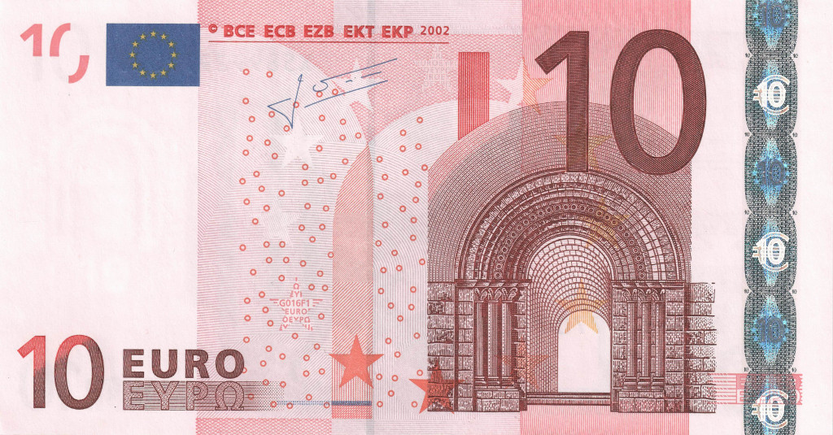
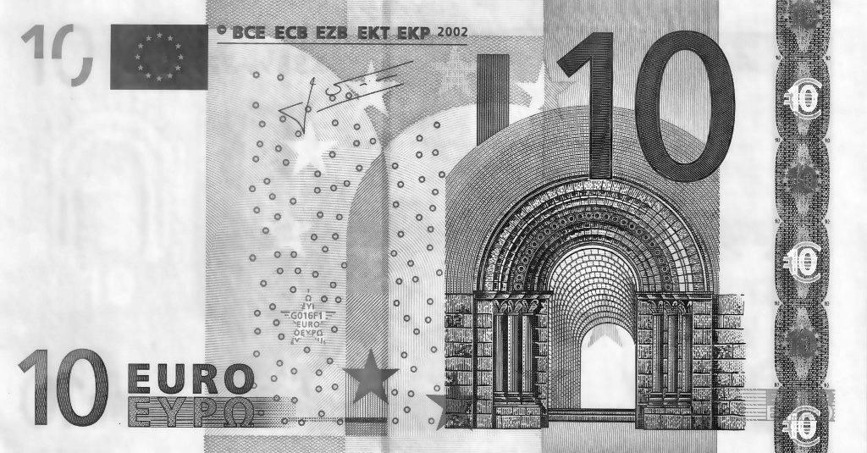
Image Processing
Bilateral Filter for Noise Reduction
Contrast Limited Adaptive Histogram Equalization (CLAHE) to increase image contrast
Pre-Processing

Slide 4
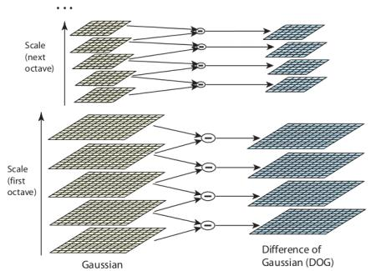
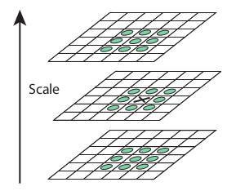
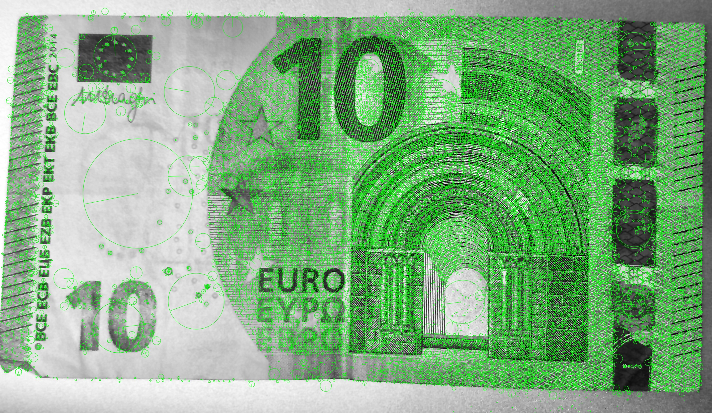
Feature Extraction: SIFT
Scale Invariant Feature Transform Algorithm (SIFT) to detect important keypoints and extract meaningful descriptors
Source: OpenCV
Source: OpenCV

Slide 5
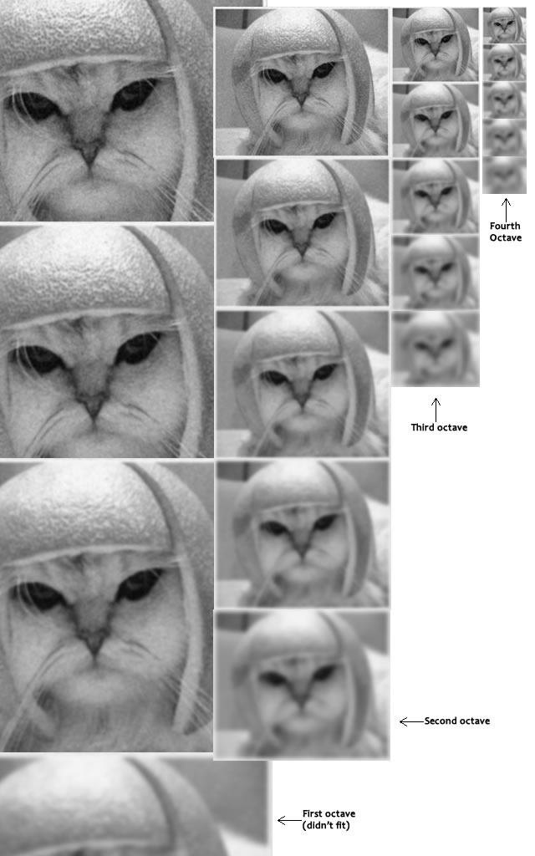
SIFT: Blurring

Slide 6
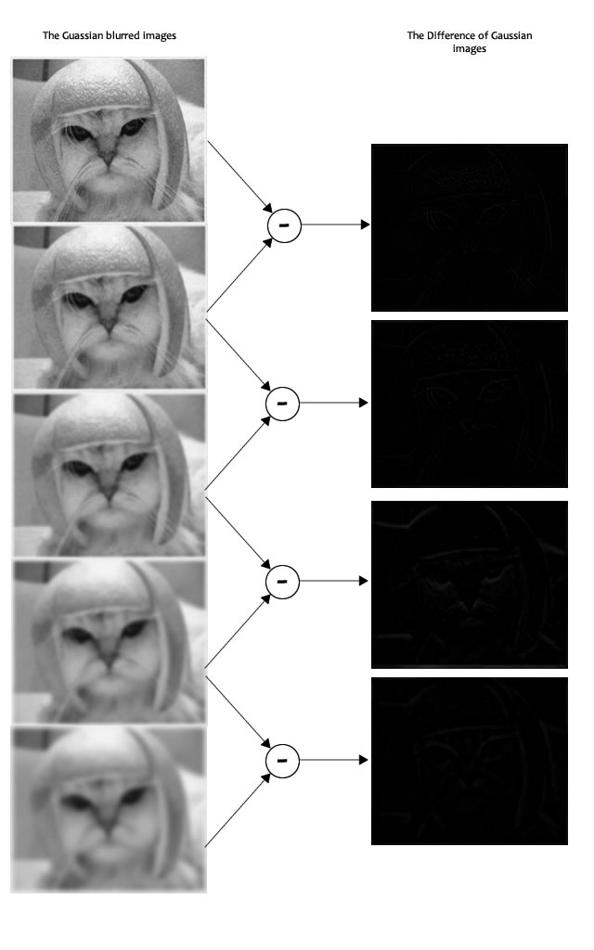
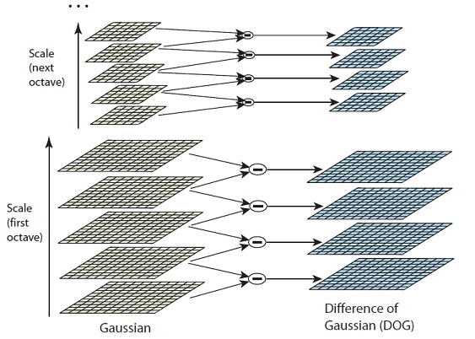
SIFT: LaplacianOfGaussian

Slide 7
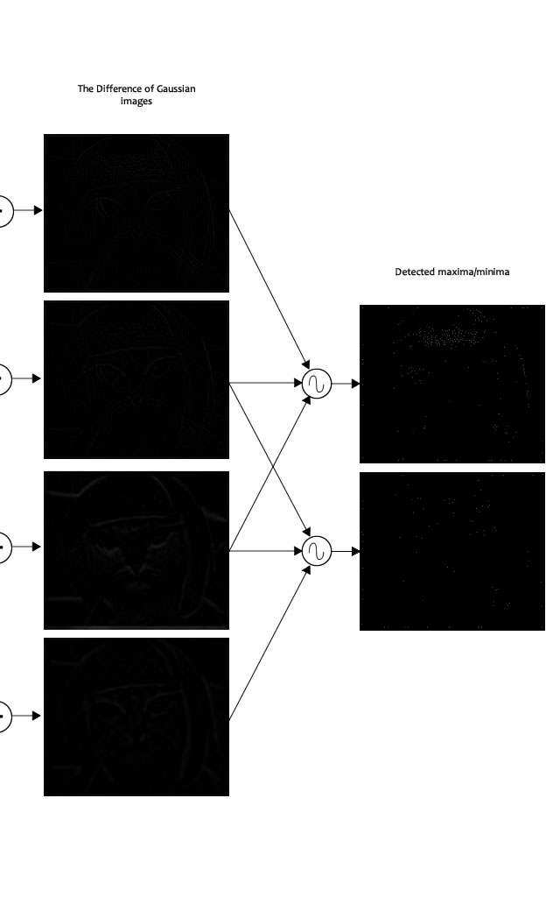
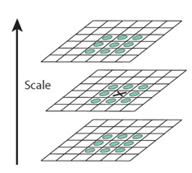
SIFT: Keypoints

Slide 8
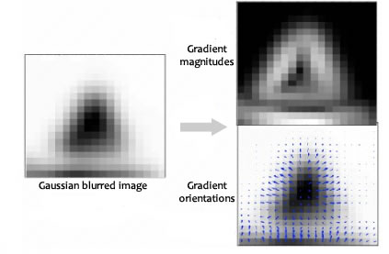
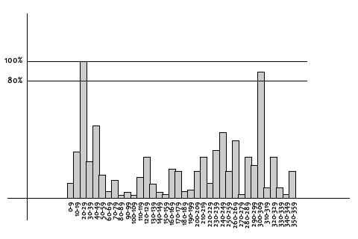
SIFT: Keypoints Orientations

Slide 9
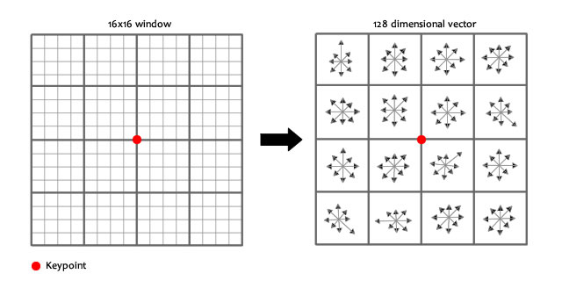
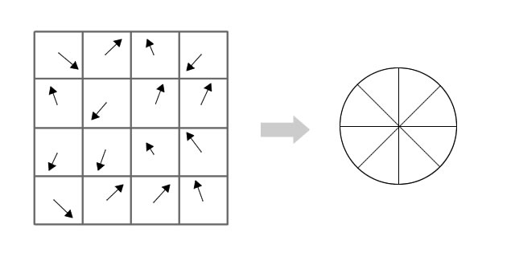
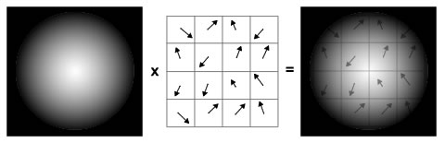
SIFT: Keypoints Orientations

Slide 10
Classification & Decision: Computer Vision Approach
Input a new image and compute SIFT descriptors
FLANN to compare descriptors from all training classes and the new image (K=2)
The pair of images with the lowest distance are the most similar
Assign new image the same class from the most similar image
This approach directly compares descriptors between the train image and the query image
Fast Library for Approximate Nearest Neighbours (FLANN), based on distance measurements to assess similarity between descriptors (e.g. K-NN Algorithm)

Slide 11
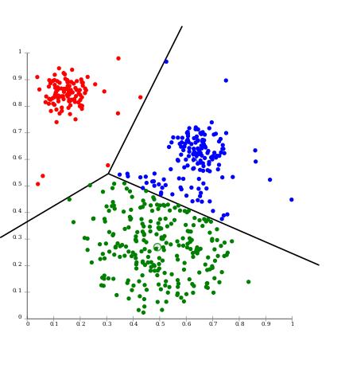

Feature Extraction: Bag of Visual Words
Create clusters of descriptors with K-Means Algorithm, using the train set
Apply our model to each individual descriptor set from the train images and obtain clusters of descriptors for each image
Count occurrences in each cluster (obtain histogram) and get the Bag of Visual Words for each image
Source: Wikipedia

Slide 12
Classification & Decision: Machine Learning Approach
This approach uses the Bag of Visual Words as input feature vector for the training algorithm
Three machine learning algorithms and classifiers were tested: Support Vector Machines, Multilayer Perceptron and Logistic Regression
Train classifier with the features from the training images
Input a new image, compute descriptors and obtain its bag of visual words
Input these features into the trained model
Compute and output prediction

Slide 13
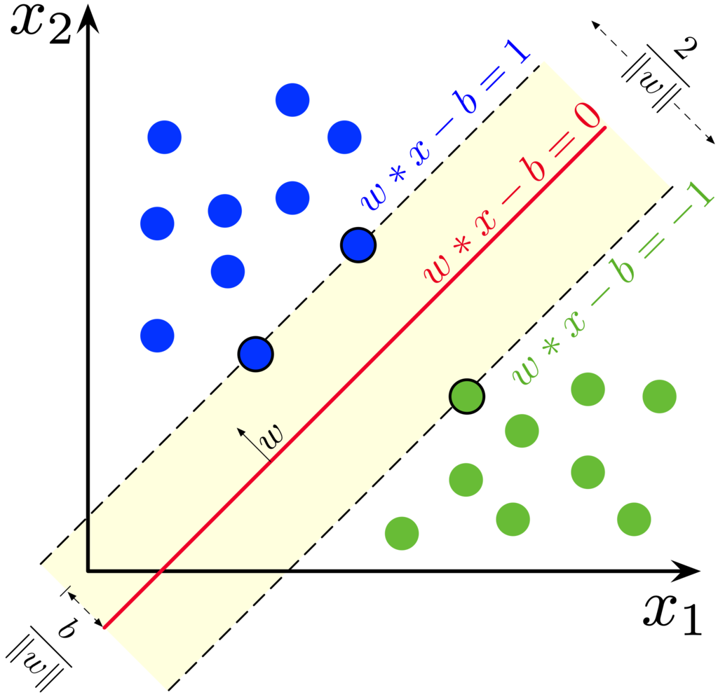
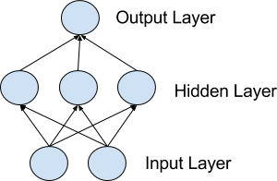
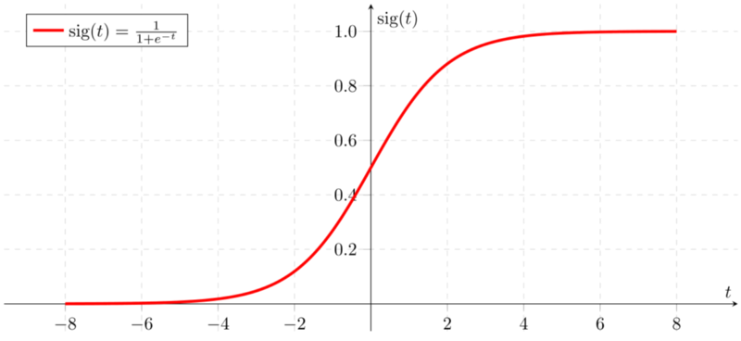
Classification & Decision: Machine Learning Approach
Support Vector Machines: learns how to separate different classes based on a hyperplane
Multilayer Perceptron: also known as Artificial Neural Network, is a simple neural network model that can also be trained to learn how to classify new samples into classes
Logistic Regression: which is a model that passes a linear function through a logistic (also know as sigmoid) function that will output a probability
Source: Machine Learning Mastery
Source: Wikipedia
Source: Towards Data Science

Slide 14





The Web Application
User
"Cloud"
Processed by CV Algorithm
RESULT

Slide 15

The Web Application

Slide 16
Final Remarks
Discussion of the Results & Conclusions
The Computer Vision approach performed better
No need to do pre-processing (SIFT are robust descriptors)
Not high time and computational costs
Lack of training data lead to bad performances on the Machine Learning approach
Future Improvements
Acquire more training data to improve performances on the Machine Learning approach
Evaluate more currency classes and extend the system to coins

Slide 17
Currency Recognition: Computer vision and machine learning
Visão Computacional
2018/2019
Tiago Filipe Sousa Gonçalves, Vitor Daniel Veigas Minhoto

